Slide 1




Git version control
FOR5159 staff retreat
26.09.2023 Freiburg
Artur

Slide 2
What is Git ?
Git is a distributed version control system
Git is a free and open source
has powerful command-line tools
GUIs also available
most prominently used in software development

Slide 3
What is version control and why should YOU care ?

Slide 4
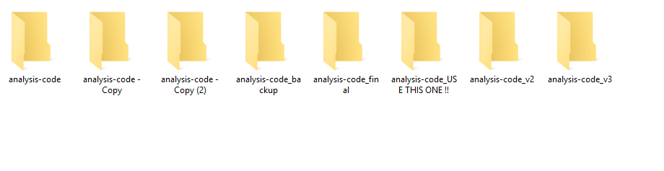
What is version control and why should YOU care ?

Slide 5
What is version control and why should YOU care ?
Advantages of using Git:
backup your work (each repository is a copy of your work and its full history)
traceability (see when/what/who made changes)
distributed work (work on same code in the office/ lab / on the train)
ability to revert to any point in history (in case you break something)
branching (add/test new features without disturbing “working copy”)
collaboration (have your college fix your bugs.. )
and many more advanced features…

Slide 6
I’m convinced, where can I get Git ?
Installing on Ubuntu:
$ apt-get install git
mac:
$ brew install git
windows:
https://git-scm.com/download/win

Slide 7
Some concepts
creating/copying a repository
making changes
branching
remote repositories

Slide 8
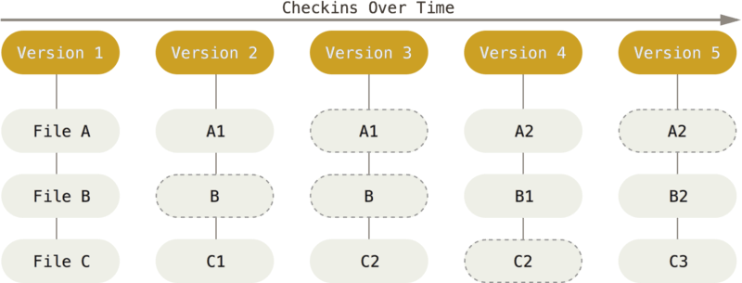
Creating/copying a repository
What is a repository ?
Stream of snapshots
File states:
4 states - untracked, modified, staged, committed
git init
git clone
git status

Slide 9
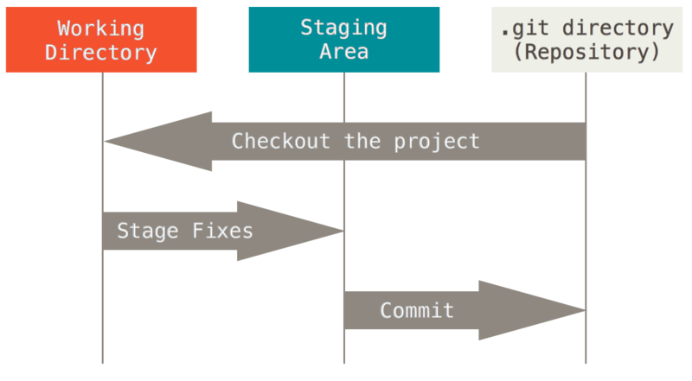
Making changes
git add
git commit

Slide 10
Task 1
Init/modifications/commits

Slide 11
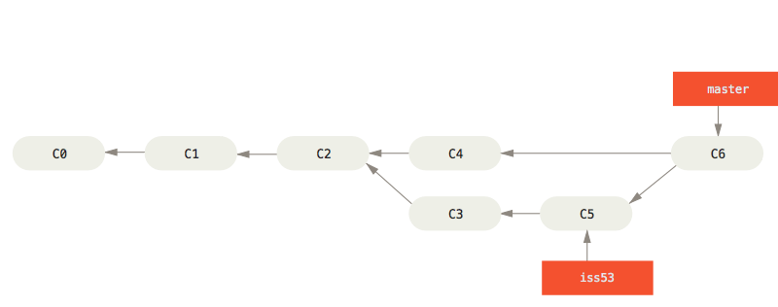
Branching
git branch
git checkout
git diff
git merge

Slide 12
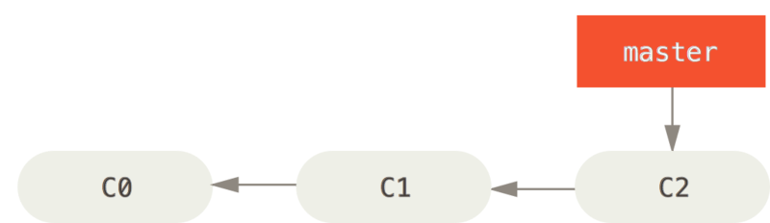
Branching

Slide 13
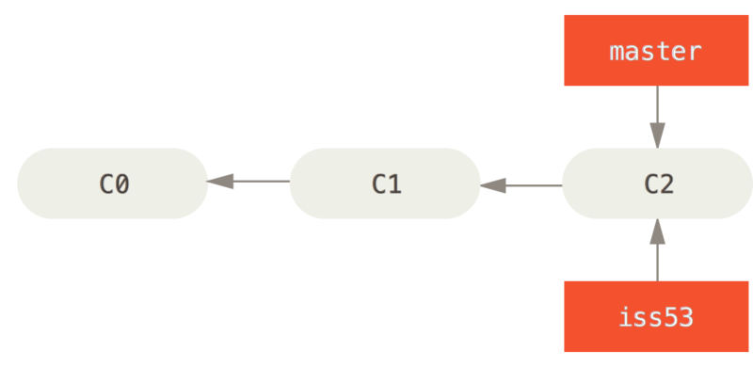
Branching
git branch

Slide 14
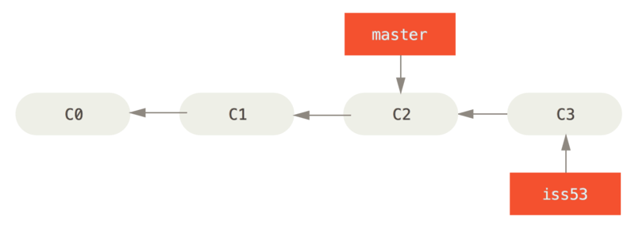
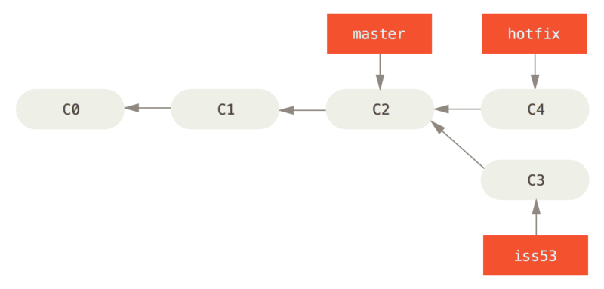
Branching
git branch
git checkout

Slide 15
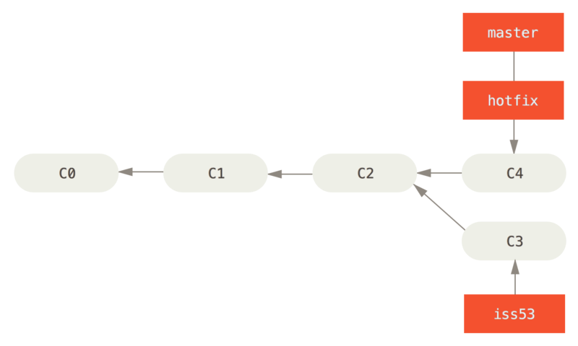
Merging
git merge

Slide 16
Task 2
Branching/Merging/Merge conflicts

Slide 17
Remote repositories
git clone
git fetch
git pull
git push
remote = somewhere else
GitHub
GitLab

Slide 18
GUIs

